Slide 1
Build Flight Assistance AI Agent Workflows
Using n8n

Slide 2
What is an AI Agent
An AI agent is an autonomous system designed to:
- Perceive its environment
- Process information intelligently
- Take actions to achieve specific goals

Slide 3
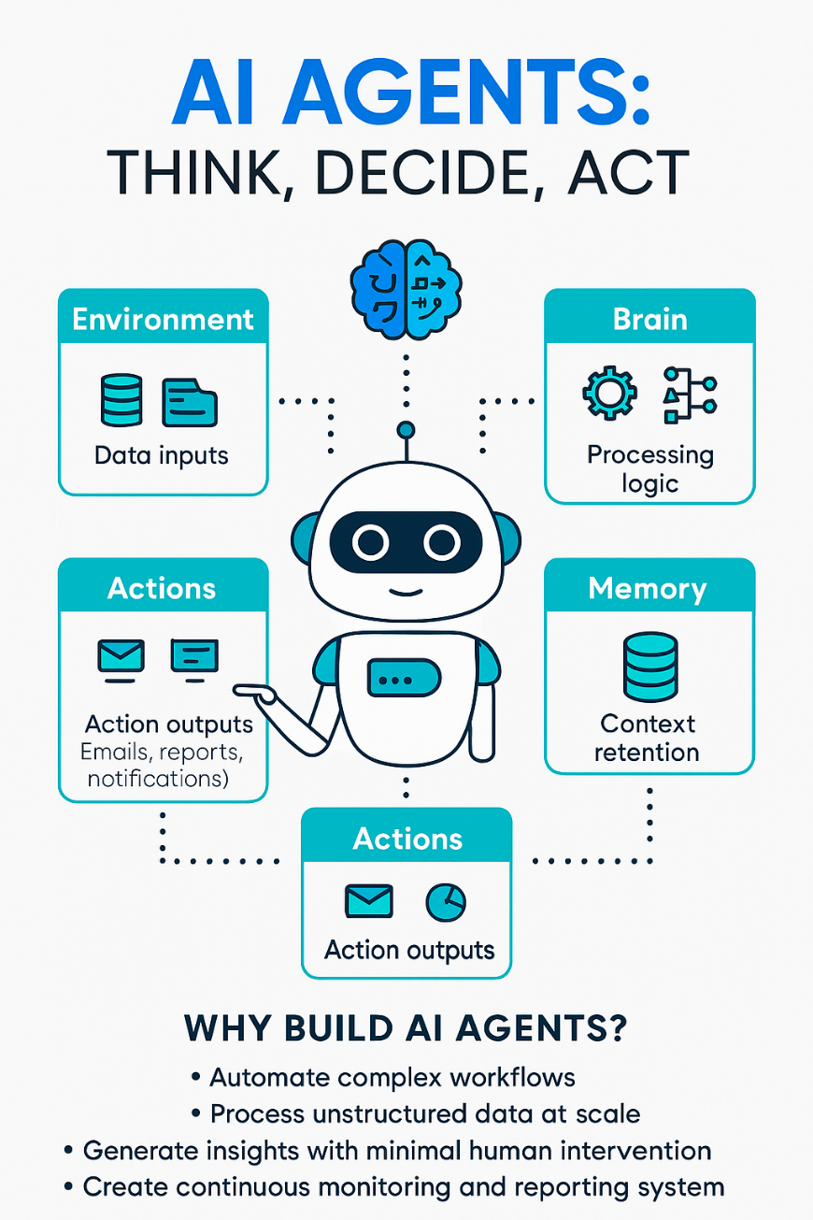
Why AI Agents
AI agents help organizations:
✅ Automate complex workflows across systems and teams
📄 Process unstructured data (text, images, logs) at scale
🔍 Generate insights with minimal human intervention
📊 Enable continuous monitoring and reporting for smarter decision-makin

Slide 4
Tools using to build AI Agent
Flight Assistant Agent
  N8n
    https://n8n.io/
    local installation:
      https://github.com/n8n-io/n8n
      https://docs.n8n.io/hosting/installation/server-setups/docker-compose/
  Telegram:
    https://telegram.org/
    https://web.telegram.org/k/
  Open AI Account:
    https://platform.openai.com
  AirTable:
    https://airtable.com/
  Chat image:
    https://chart-img.com/
    https://aviationstack.com/confirm-email

Slide 5
How to Get Telegram Access Key
Open Telegram APP in your mobile or browser
Search for BotFather from the Telegram Chat. Make sure you pick @BotFather which is verified and you can see check mark on the bot.
On the BotFather chat window,
  You can see all the instructions on the window.
  Type in /newbot.
  It will ask you to name the bot.
  Give a name for the bot. Make sure bot name should end with ‘bot’
  BotFather will respond with the bot details like your bot link, and the bot API key. Save the token.

